Slide 1
ACTIVITY – 1 Take one sample of soil and one sample of sand. Try to grow a plant in each. Now using food scraps, prepare compost and use it to convert the sand into soil so that it is suitable for the growth of the plant. Note down the amount and kind of waste used for the same. Relate this with the role of deforestation in desertification and discuss how it can be stopped across the world.
(Environmental Studies)
BY
RITIK KUMAR
41221131
BCA – 2ndsem

Slide 2
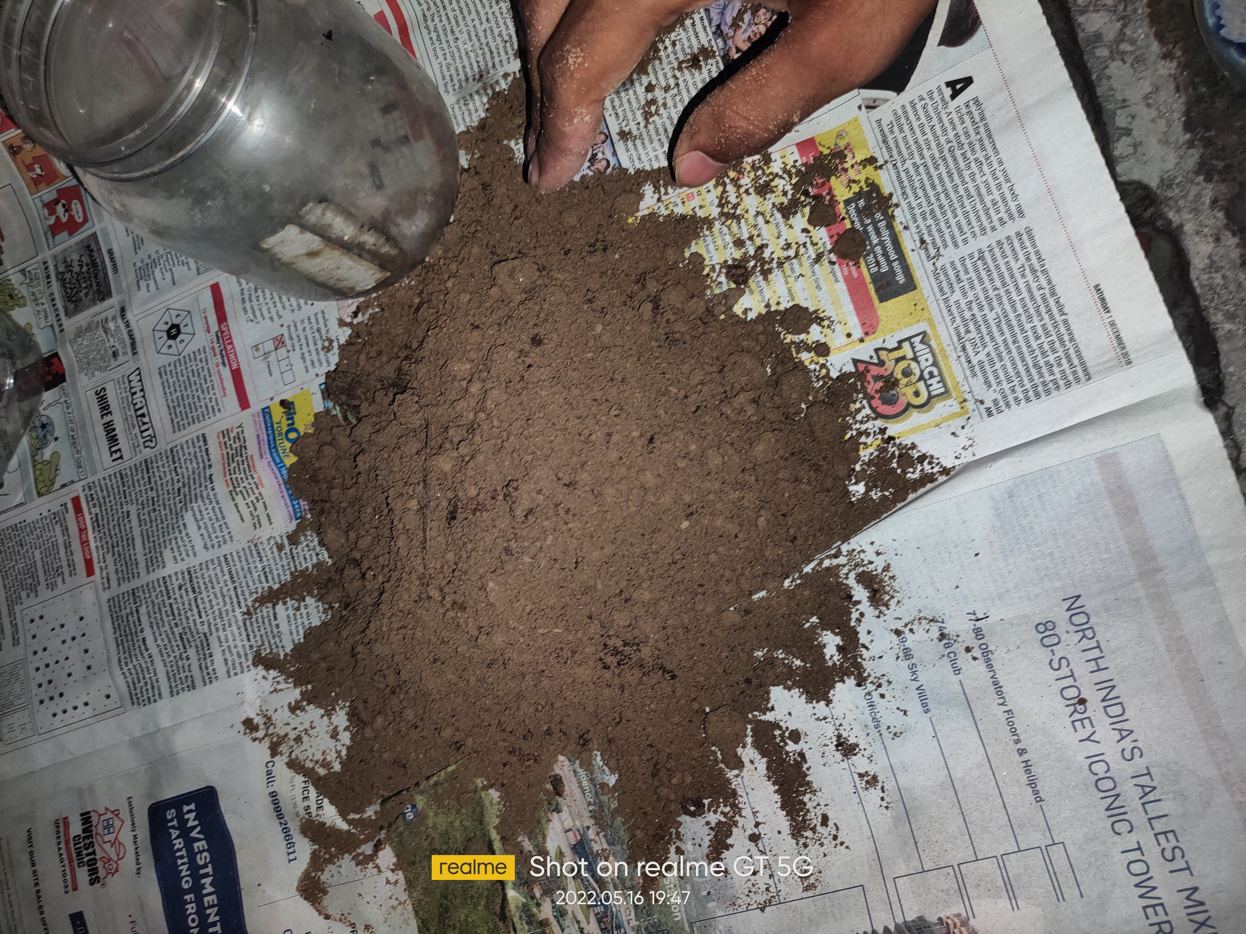
SAMPLE OF SOIL

Slide 3
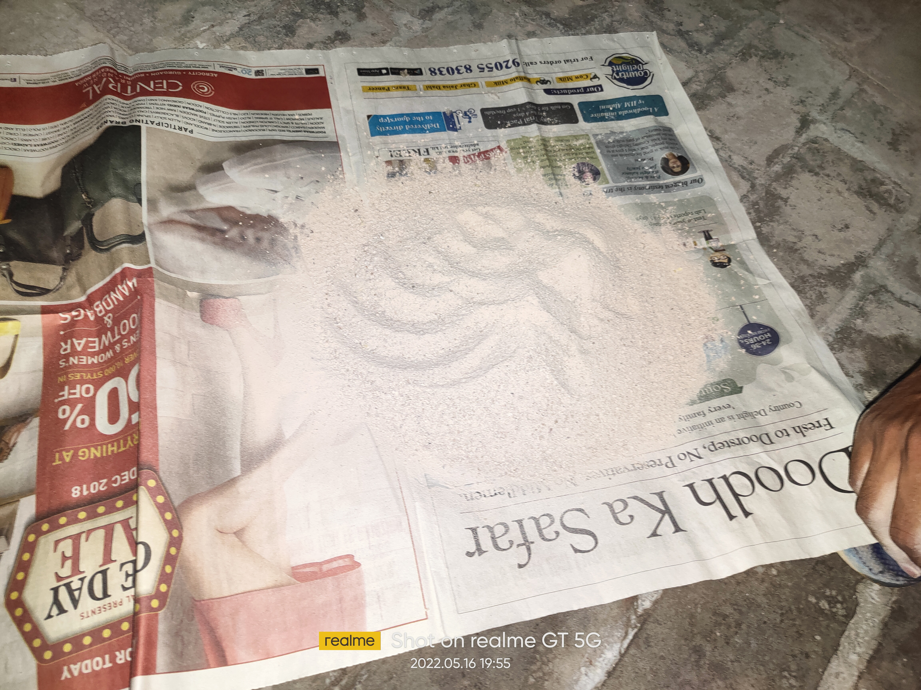
SAMPLE OF SAND

Slide 4
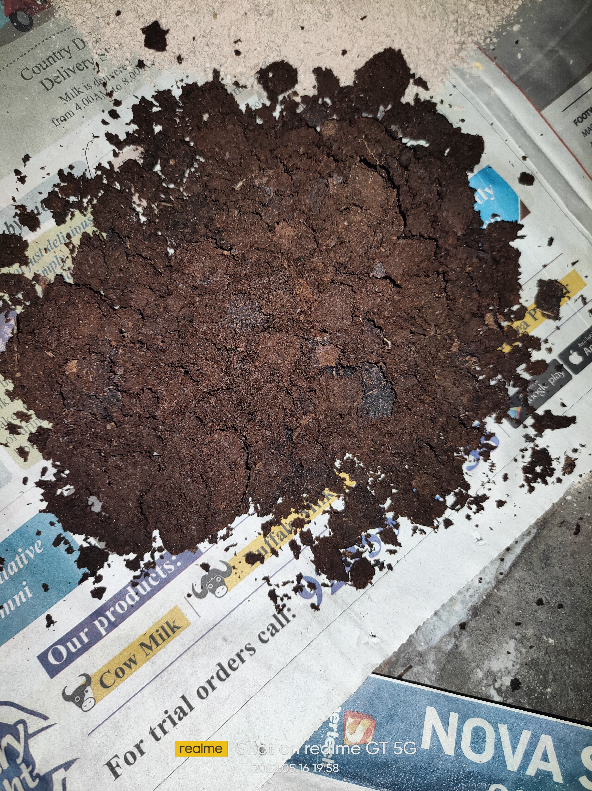
COMPOST
MIXER OF COW DUNG,DRY LEAVES,VEGETABLES AND FRUIT PEELS ETC.

Slide 5
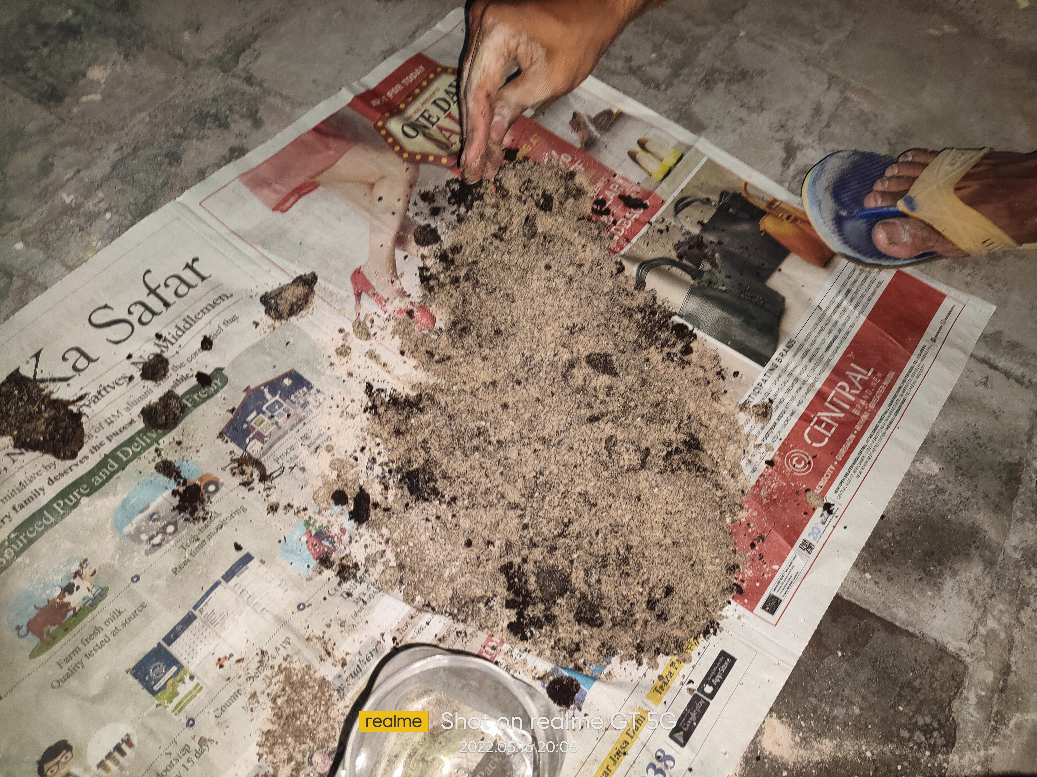
MIXTURE OF SAND AND COMPOST

Slide 6
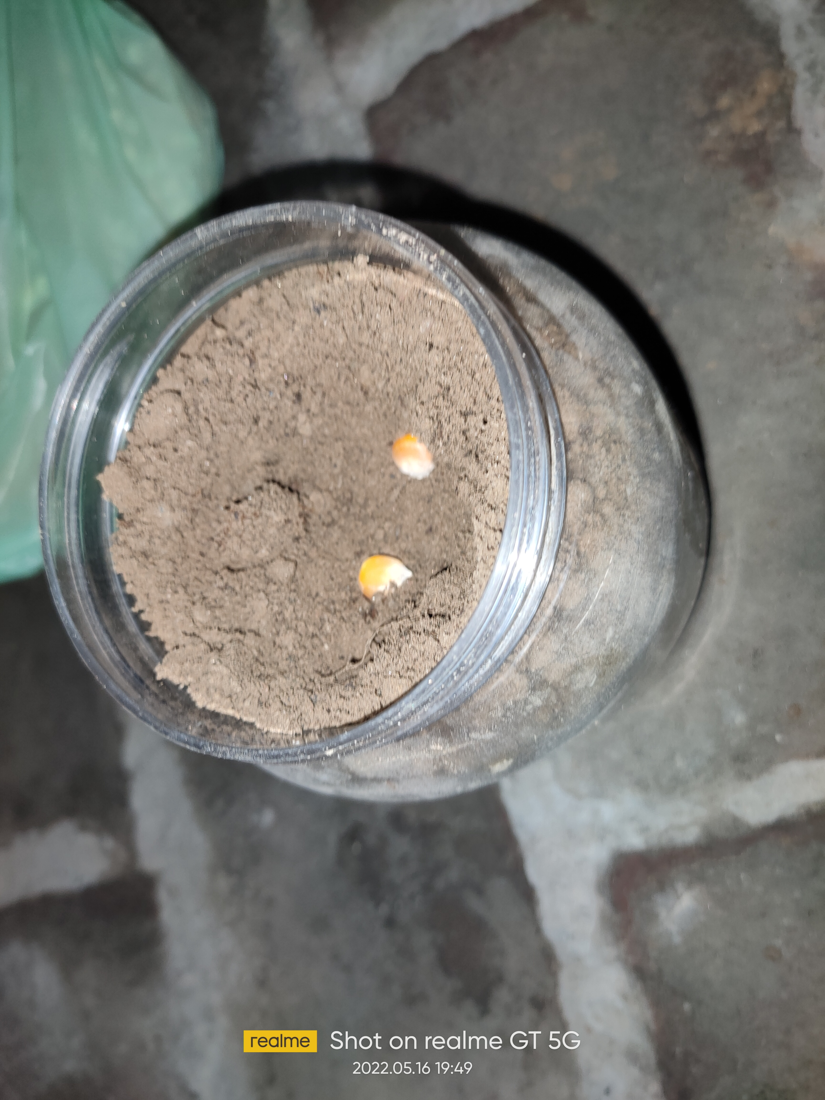
PLANTING MAIZE IN SAND

Slide 7
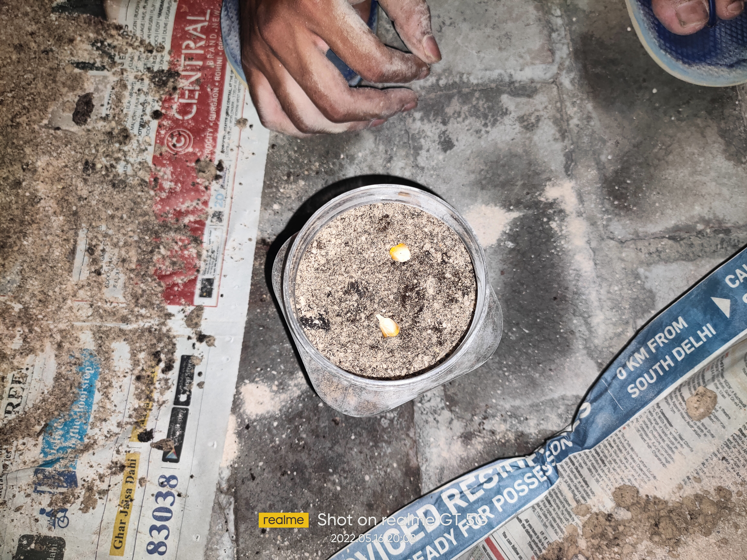
PLANTING MAIZE IN SAND WITH COMPOST

Slide 8
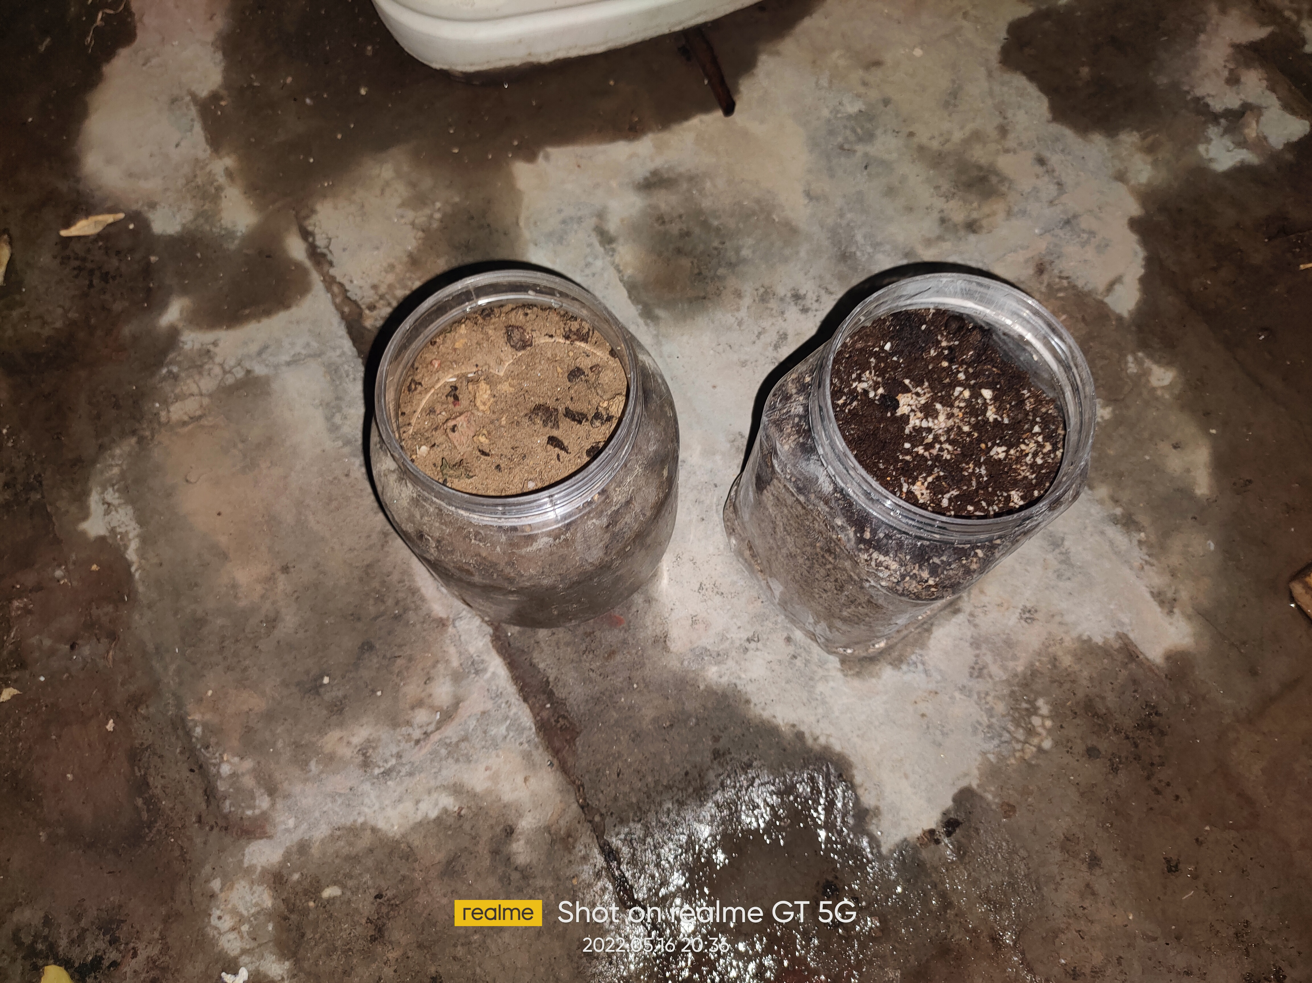
BOTH ARE READY TO GROW
Soil
Sand + Compost

Slide 9
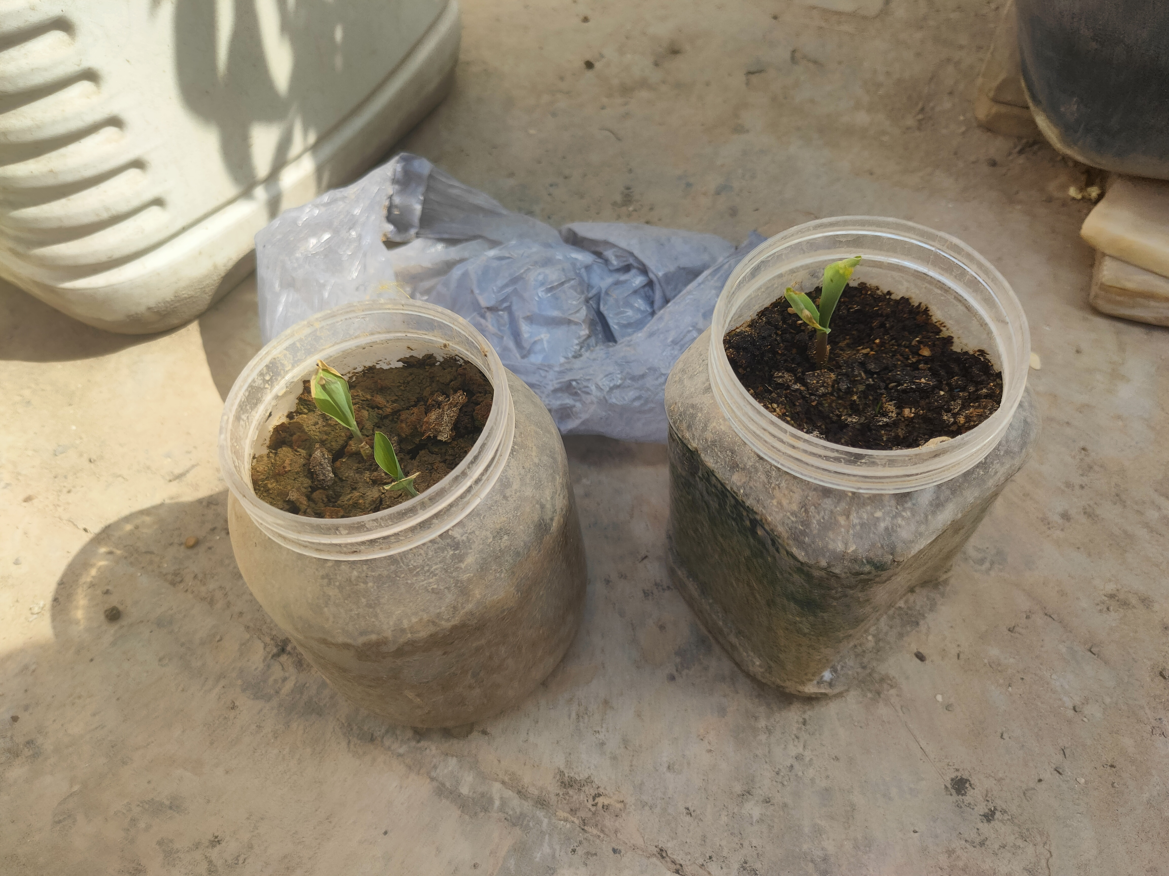
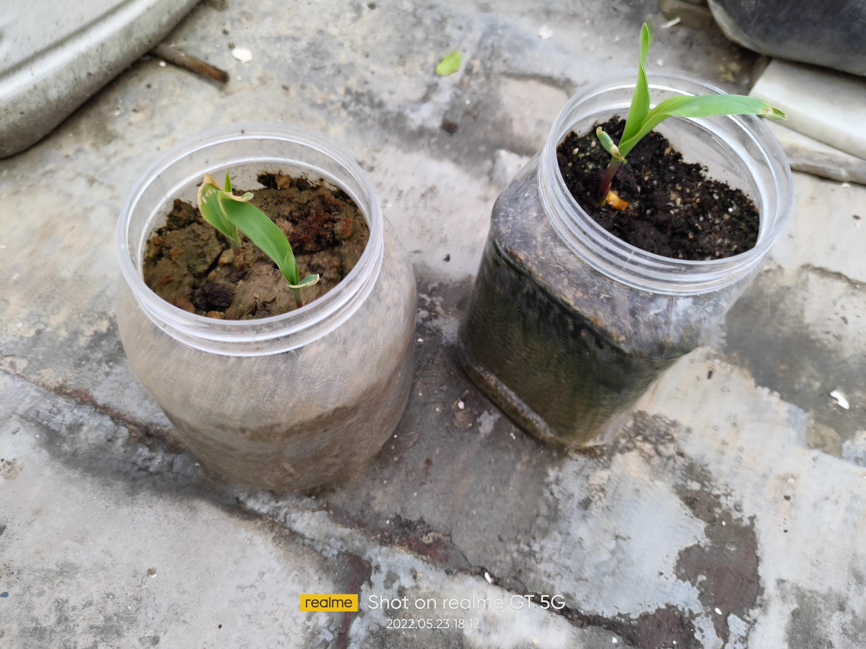
Plant Growth

Slide 10
